Slide 1
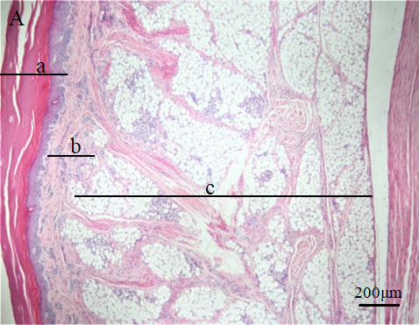
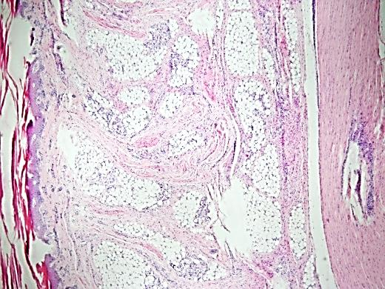
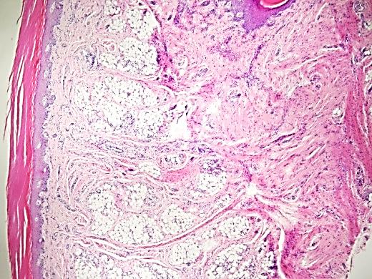
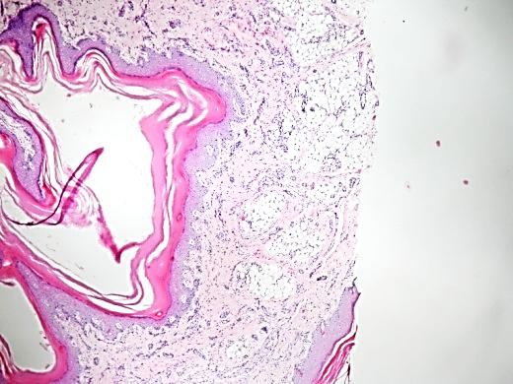
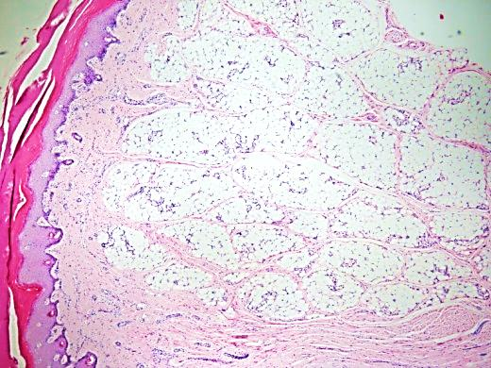
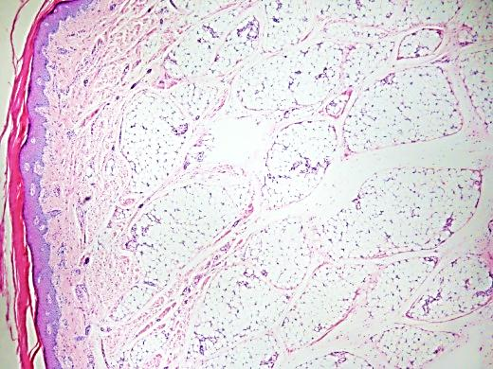
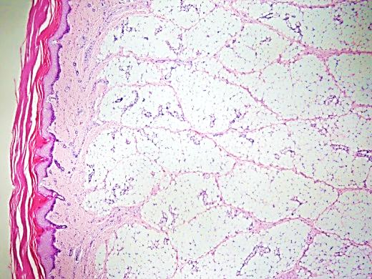
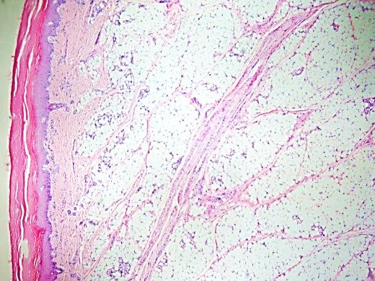
1. Histological results of different parts of paw pads from No.1 cat. The magnification of tissue structure is 40×. Fig.A-Fig.F are from digital pads, and Fig.G-Fig.H are from metacarpal pad. The “a” area is stratified epithelium, “b” area is dermis layer and “c” area is subcutaneous tissue layer in Fig. A.
B
C
D
200um
200um
200um
E
F
G
H
200um
200um
200um
200um

Slide 2
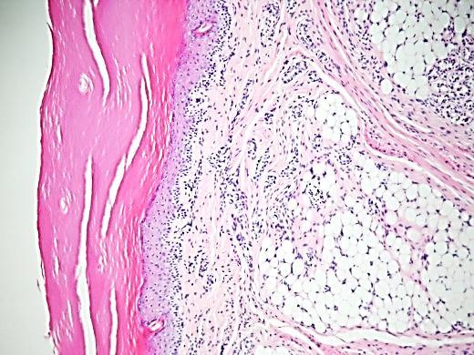
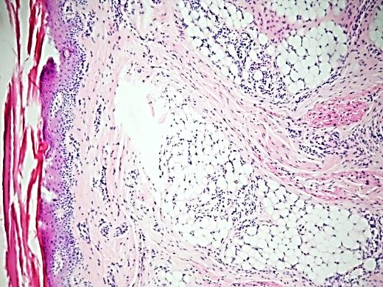
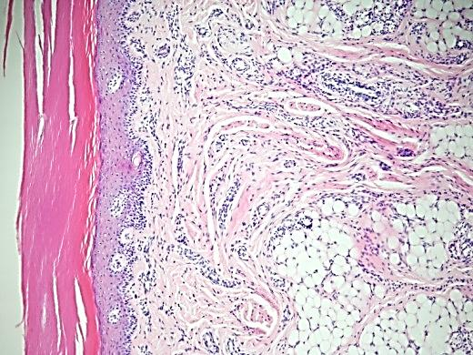
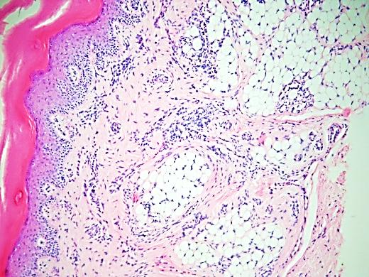
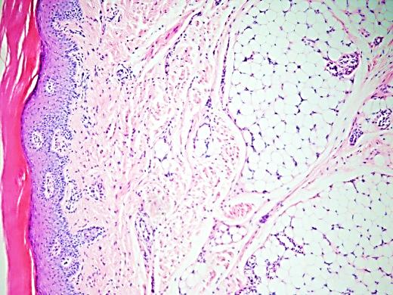
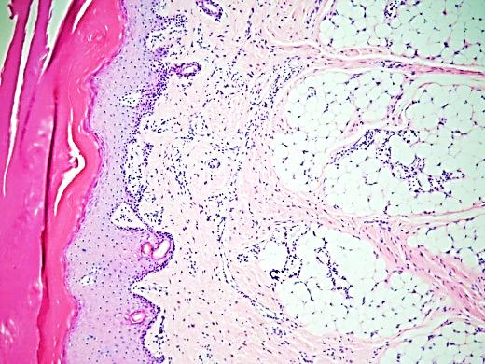
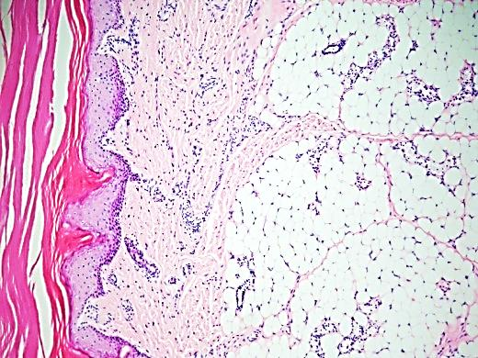
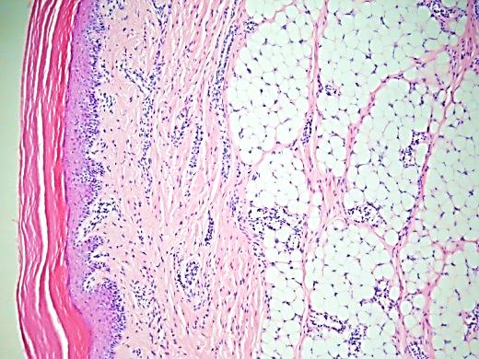
2. Histological results of different parts of paw pads from No.1 cat. The magnification of tissue structure is 100×. Fig.A-Fig.F are from digital pads, and Fig.G-Fig.H are from metacarpal pad.
A
B
C
D
50um
50um
50um
50um
E
F
G
H
50um
50um
50um
50um

Slide 3
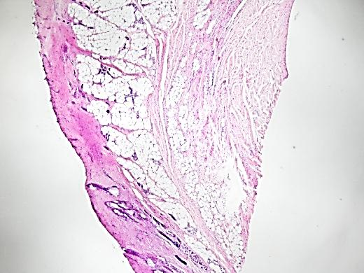
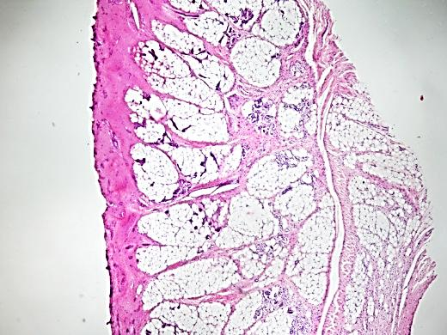
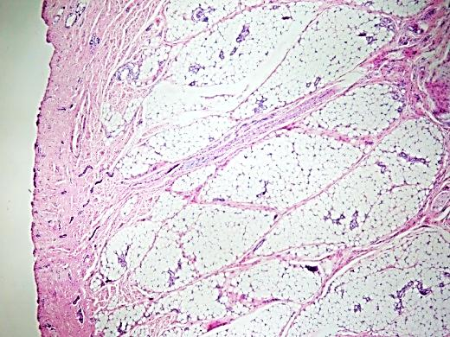
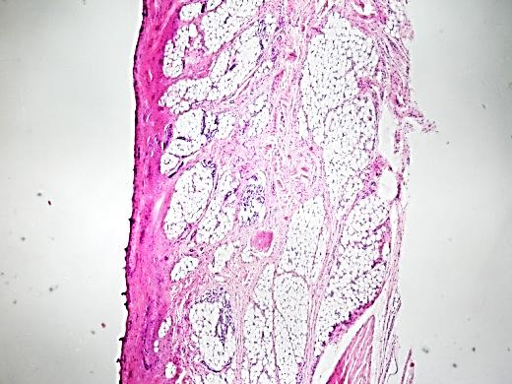
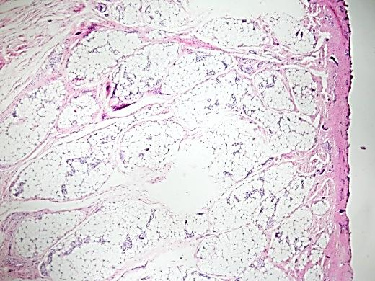
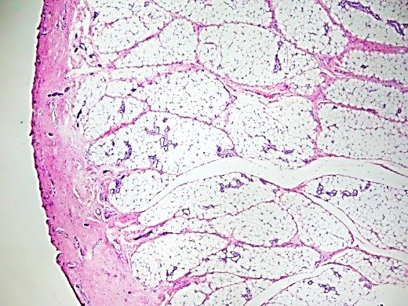
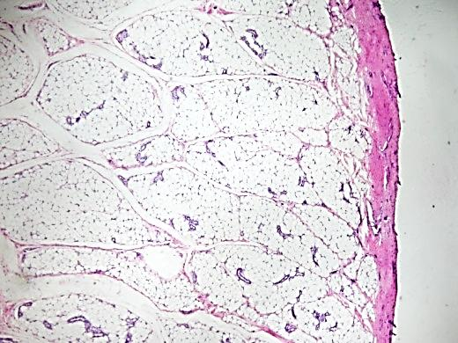
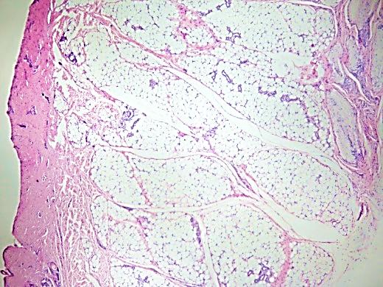
3. Histological results of different parts of paw pads from No.2 cat. The magnification of tissue structure is 40×. Fig.A-Fig.F are from digital pads, and Fig.G-Fig.H are from metacarpal pad.
A
B
C
D
200um
200um
200um
200um
E
F
G
H
200um
200um
200um
200um

Slide 4
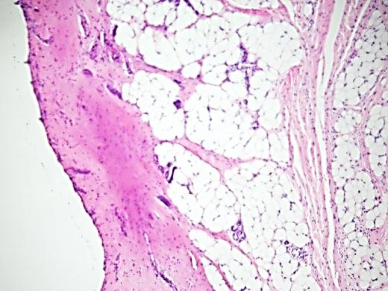
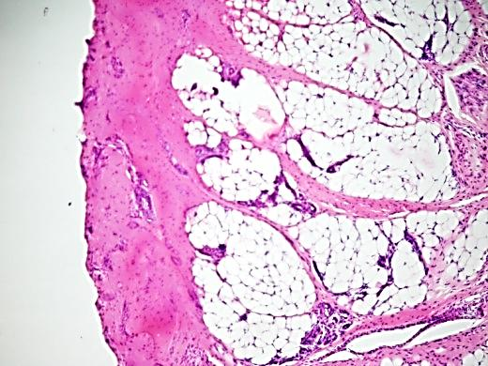
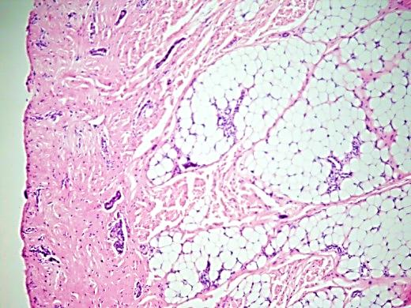
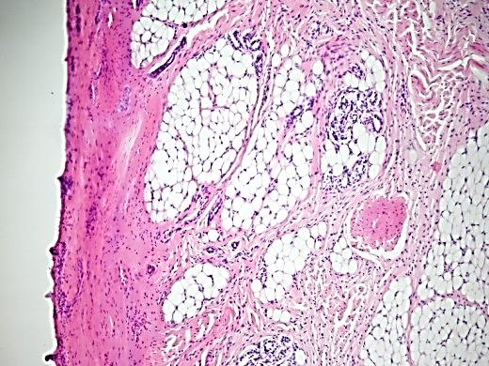
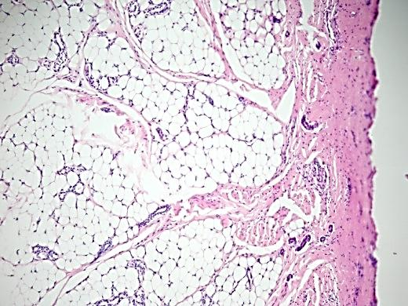
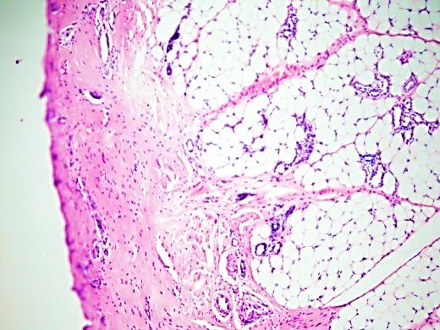
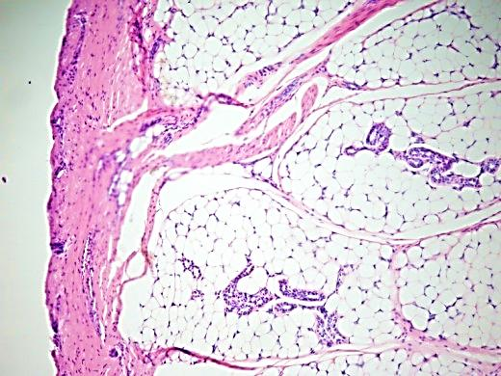
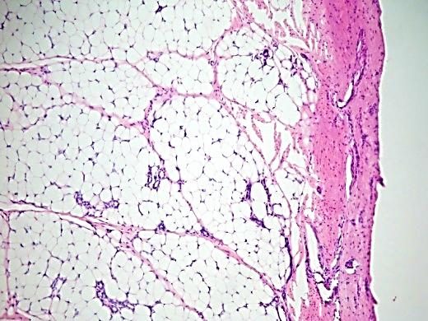
4. Histological results of different parts of paw pads from No.2 cat. The magnification of tissue structure is 100×. Fig.A-Fig.F are from digital pads, and Fig.G-Fig.H are from metacarpal pad.
A
B
C
D
50um
50um
50um
50um
E
F
G
H
50um
50um
50um
50um

